Slide 1
Agentic AI for Autonomous DevOps Optimization Using LLMs and MCP"
Develop an Agentic Al system for DevOps to autonomously optimize the software development lifecycle using advanced reasoning, real-time adaptability, and multi-step problem-solving. Leveraging LLMs and tools like MCP, it will enhance CI/CD pipelines, automate tasks like code reviews, testing, and deployment, and improve collaboration between development and operations teams for efficiency and reliability

Slide 2
What is the problem:
DevOps today faces issues like manual processes, slow CI/CD pipelines, and weak collaboration between teams. An Agentic AI system using LLMs and MCP can solve these by automating tasks like code reviews, testing, and deployments. It uses advanced reasoning to adapt in real time and solve multi-step problems across the software lifecycle. Intelligent agents work together to detect issues, optimize workflows, and improve system reliability. This leads to faster delivery, reduced errors, and better coordination between development and operations teams.

Slide 3
Problem:
┌─────────────────────┐
│ Developer Actions │
└────────┬────────────┘
│
▼
┌──────────────┐
│ MCP + LLM AI │ ← Orchestration & Reasoning Layer
└─────┬────────┘
│
┌──────────────────────┼─────────────────────────┐
│ │ │
▼ ▼ ▼
[GitHub] [Test Generation] [CI/CD Pipelines]
(Pull Request) (Unit/Integration) (GitHub Actions / Jenkins)
│ │ │
▼ ▼ ▼
[Code Review Bot] [AutoTest Runner] [Deploy Decision Engine]

Slide 4
How does it occurs :
The Agentic AI system works by using LLMs and specialized agents that analyze, reason, and automate tasks across the DevOps lifecycle. These agents collaborate through MCP to optimize CI/CD pipelines, testing, and deployment in real time.

Slide 5
What is solution
Use LLMs: Automate code reviews, testing, and deployment with language models.
Multi-Agent System: Assign specialized agents that collaborate via MCP.
CI/CD Optimization: Auto-detect and fix pipeline issues in real time.
Real-Time Adaptability: Learn from data to improve decisions instantly.
Boost Collaboration: Use natural language tools for Dev-Ops teamwork.
Self-Improving System: Continuously refine actions through feedback.
Scalable Infra Support: Auto-manage cloud resources and environments.

Slide 6
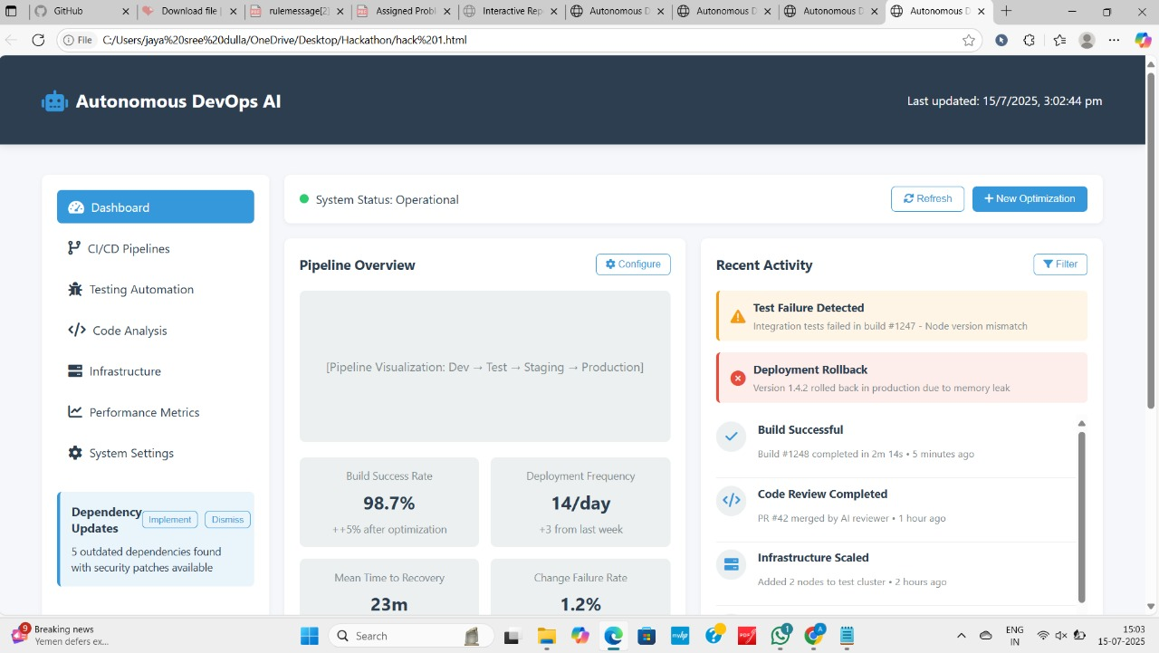
CREATED WEBPAGE:

